Slide 1
Marketing Analytics
Session 2
R & ODBC

Slide 2
Agenda
R
What is R and RStudio?
Help
Data structures
Helpful functions
Custom functions
Plotting
ODBC
How to make R talk to MySQL
Tips and tricks
Pre-allocating memory
Variable scope

Slide 3
R
Session 2

Slide 4
What is R? RStudio?
R is free statistical software
R is a programming language
Highly extendable. Users can write functions and easily add software libraries to R
Interactive. You type what you want and get out the corresponding results
RStudio is a freely available IDE
Integrated Development Editor

Slide 5
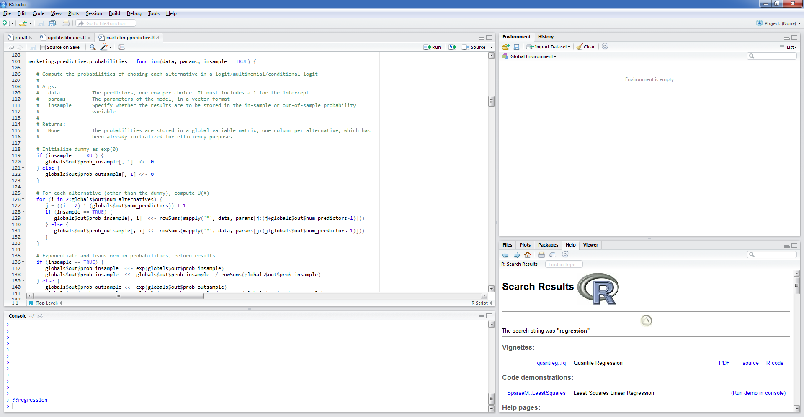
RStudio

Slide 6
Get help
# Help about a specific function
Help(lm)
?lm
# Help related to a specific keyword
??logarithm

Slide 7
Data structures
R operates on data structures, "containers" that hold data. Common R data structures:
Vectors
A sequence of numerical, character, factor, or logical data
Note that a single value is internally managed as a vector of length 1
Matrices
Multi-dimensional collection of vectors of the same type
Lists
A multi-dimensional collection of… data structures
Data frames
A specific type of list containing only vectors of identical length, but possibly of different types (inbreed between matrix and list)

Slide 8
Creating vectors
# Concatenate values
c(1, 2, 3)
c("one", "two", "three")
c(TRUE, FALSE, TRUE)
# Create a sequence (long and short forms,
# with options)
seq(1, 10)
1:10
seq(0, 1000, by = 7)
seq(1, 10, len = 200)
# Repeat values
rep("yes", 10)
rep(1:3, 10)

Slide 9
Assigning variables
# These are equivalent (I prefer the first)
x = 10
x <- 10
# This is slightly different (cf. scope)
x <<- 10
# 3 examples...
x = seq(1, 100)
a = 1:10
b = 9:1
x = c(a, b)
x = rep(c(1, rep(0, 9)), 10)

Slide 10
Operations
# By design, operations are applied to all the
# elements of a data structure
x = 1:10
y = x^2
z = y - x
x = z + 20
# Useful functions
length(x) # length of x
sum(x) # sum elements in x
mean(x) # mean of elements in x
var(x) # sample variance of elements in x
sd(x) # standard deviation of elements in x
range(x) # range of elements in x
log(x) # logarithm of elements in x
sqrt(x) # returns the square root of elem. in x
summary(x) # summary of x

Slide 11
Accessing elements in a vector
# Our basic vector
x = (1:10)^2
# Accessing specific elements
x[7]
x[2:4]
x[c(2,3,4)]
x[c(2:4, 7)]
x[-10]
x[ seq(1, 10, by=2)]
x[-seq(1, 10, by=2)]
x[10:1]

Slide 12
Console versus .R files
You can enter commands in the console… or enter them in a text file, called an R script (.R extension), and then "execute" the script
Easiest way to execute an R script
Click on "Source on Save" in Rstudio, then save it
R scripts are essential to:
Executing and saving large sequences of commands
Creating functions (coming next)
But they do not output results on the console
You need to print(…) what you want to see

Slide 13
Functions
A function is a sequence of commands executed based on certain arguments supplied to the function
All arguments have a name
Some arguments are optional
But they need default values
R functions may return values, or not…

Slide 14
Example of a simple function
# Return the value 1, does not have any parameter.
# The name of the function is "justone"
justone = function() {
return(1)
}
# Note the brackets, even with no parameter
x = justone()
print(x)

Slide 15
Example of a more complex function
# Return the standard deviation of a vector
stdev = function(x) {
s = sqrt(sum(((x - mean(x))^2))/(length(x) - 1))
return(s)
}
# Test it
z = seq(0, 10)
s = stdev(z)
print(s)

Slide 16
Calling a function with parameters
# Print a string containing the result of an
# addition. Does not return anything
fun = function(x, y, z=2, w=5) {
print(paste(x, "+", y, "+", z, "+", w,
"=", x + y + z + w))
}
# See how the calls differ
# The last one will return an error
fun(1, 10)
fun(x=1, y=10)
fun(1, 10, 3)
fun(1, 10, w=3)
fun(y=10, x=5)
fun(10)

Slide 17
On naming function
# If you save this function in an R script named
# "stdev.R", and there is only one function in that
# script, these are equivalent
stdev = function(x) {
...
}
# I don't like the latter, if only because you may
# screw up by renaming the file, but...
function(x) {
...
}

Slide 18
Multidimensional data structures
Matrix
Each dimension (column) has the same length
Each column has the same type (e.g., numerical)
List
Each dimension may differ in length and type
Each dimension has a name (by default, "x1", "x2", etc.)
Data frame
Hybrid form
Each dimension (column) has the same length
Each column can have a different type
Each dimension has a name (by default, "x1", "x2", etc.)
Is managed internally as a list

Slide 19
Creating and accessing matrices
# Create a magic square
# Note that ncol and nrow are redundant here
magic = matrix(c(7, 12, 1, 14, 2, 13, 8, 11,
16, 3, 10, 5, 9, 6, 15, 4),
ncol=4, nrow=4)
# Access a matrix by index, matrix(row, column)
magic
magic[1, ]
magic[, 3]
magic[2:3, 2:3]

Slide 20
Manipulating matrices
# Basic operations on matrices
sum(magic) # sum all its elements
rowSums(magic) # sum by rows
colSums(magic) # sum by columns
t(magic) # transpose
cbind(magic, magic) # bind by column
rbind(magic, magic) # bind by row
diag(magic) # extract the diagonal
sum(diag(magic))
sum(diag(t(magic)))

Slide 21
Creating and accessing lists
# Create a list containing a vector, text, matrix
# Note how the values c(0, 1) are recycled to
# create the matrix
m = list(x = c(1,2,3,4),
y = "hello world",
z = matrix(c(0, 1), ncol=4, nrow=5))
# You access one element of a list like this...
# They are all equivalent. Note the double brackets
# on the third line.
m$z
m["z"]
m[[3]]

Slide 22
Creating and accessing lists
m = list of 3 elements
m[1] = list of 1 element
m[[1]] = the content of the 1st element of the list

Slide 23
Creating and accessing data frames
# Create a data frame. Like a list, but each
# dimension must be of the same length
d = data.frame(id = c(1,2,3,4),
name = c("Jon", "Mary", "Jil", "Kim"),
GPA = c(4.0, 3.2, 4.0, 2.9))
# A data frame is a list-matrix hybrid
# Access it like a list
d$name
d["name"]
d[[2]]
# Or like a matrix
d[2, ]
d[, 2]
# And so...
mean(d$GPA)
d$name[4]
d[[2]][4]

Slide 24
Plotting data
# Create a basic sequence of numbers
x = seq(-3, 3, len=1000)
z = x^2
# Basic line plot
plot(z)
# Histogram
hist(z)
# Scatter plot
plot(z, x)
# Box plot
boxplot(z)

Slide 25
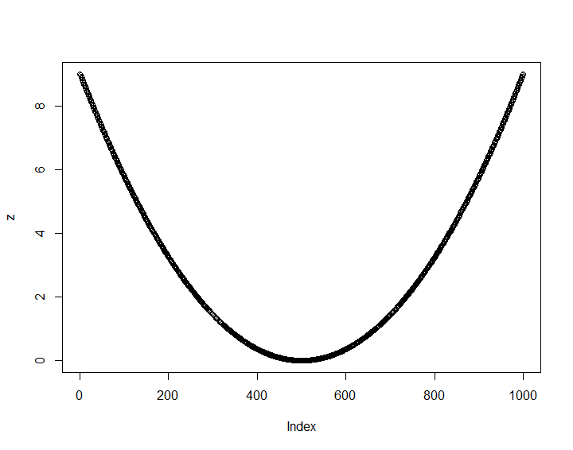
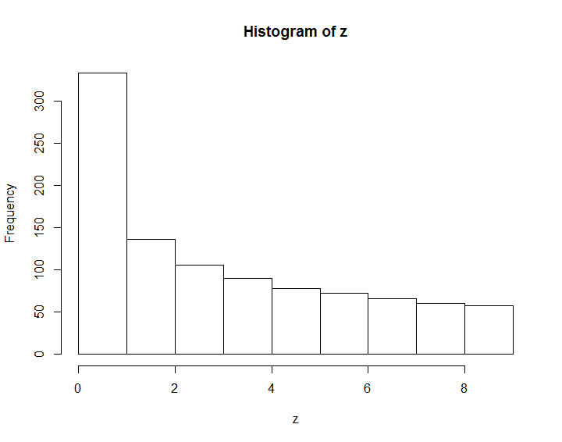
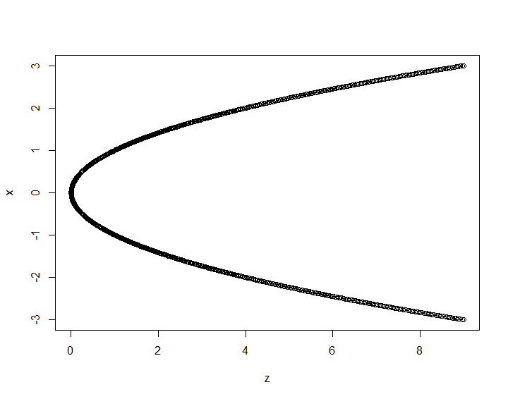
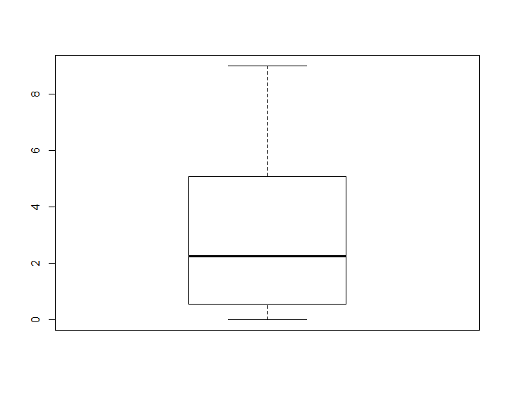
Plotting data

Slide 26
ODBC
Making R and MySQL talk to one another

Slide 27
ODBC
ODBC stands for Open DataBase Connectivity
It creates a "bridge" between a database (e.g., MySQL) and any language that can talk to an ODBC connection

Slide 28

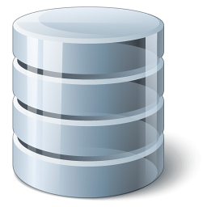
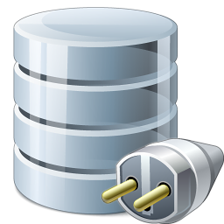
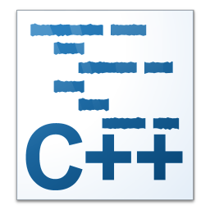
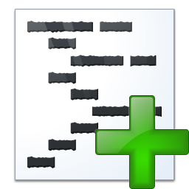

How to connect MySQL to…
NATIVE CONNECTION
CONNECTOR/C++
CONNECTOR/ODBC
ODBC LIBRARY
Note : we will NOT use the R library called MySQL, which is full of bugs and not maintained

Slide 29
Installation steps
For MySQL
Download ODBC Driver for MySQL (Connector/ODBC)
Install it
Create and name an ODBC connection (or channel/data source) See next slides
For R
Install the "RODBC" library
Connect to the ODBC connection (or channel)
Run queries
On Windows, make sure that MySQL, the Connector/ODBC, and R are all 32-bit or 64-bit applications. Do not mix and match
Great resources :
http://cran.r-project.org/web/packages/RODBC/vignettes/RODBC.pdf
http://www.joyofdata.de/blog/make-r-talk-to-mysql-on-windows/

Slide 30
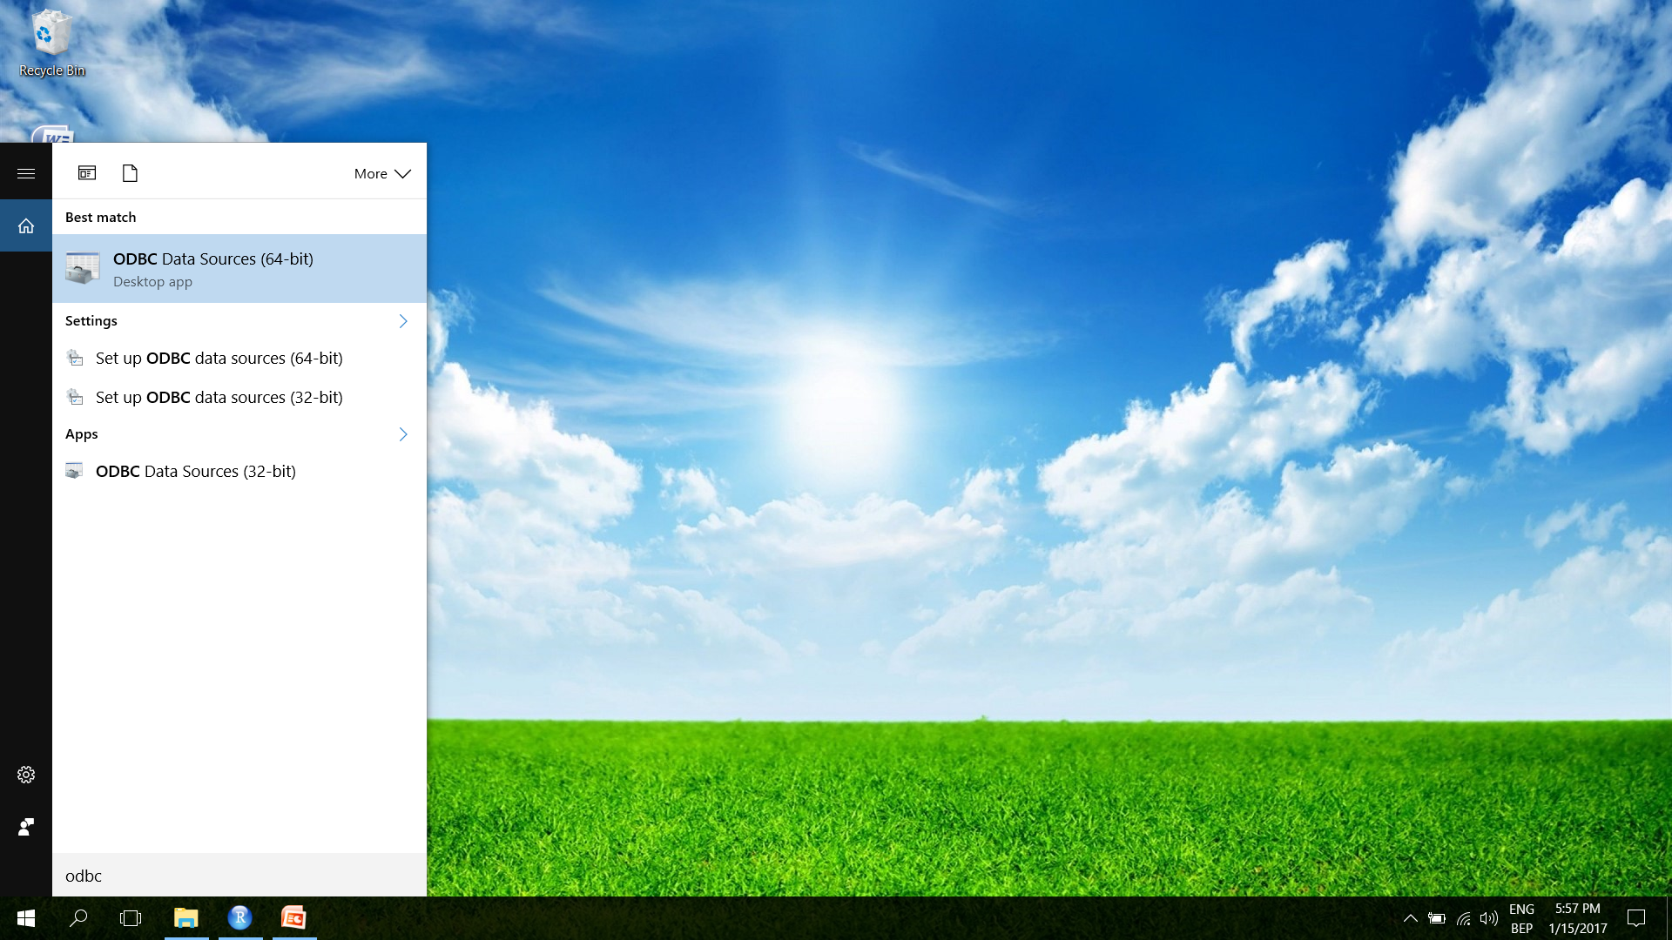
Find the ODBC data source manager

Slide 31
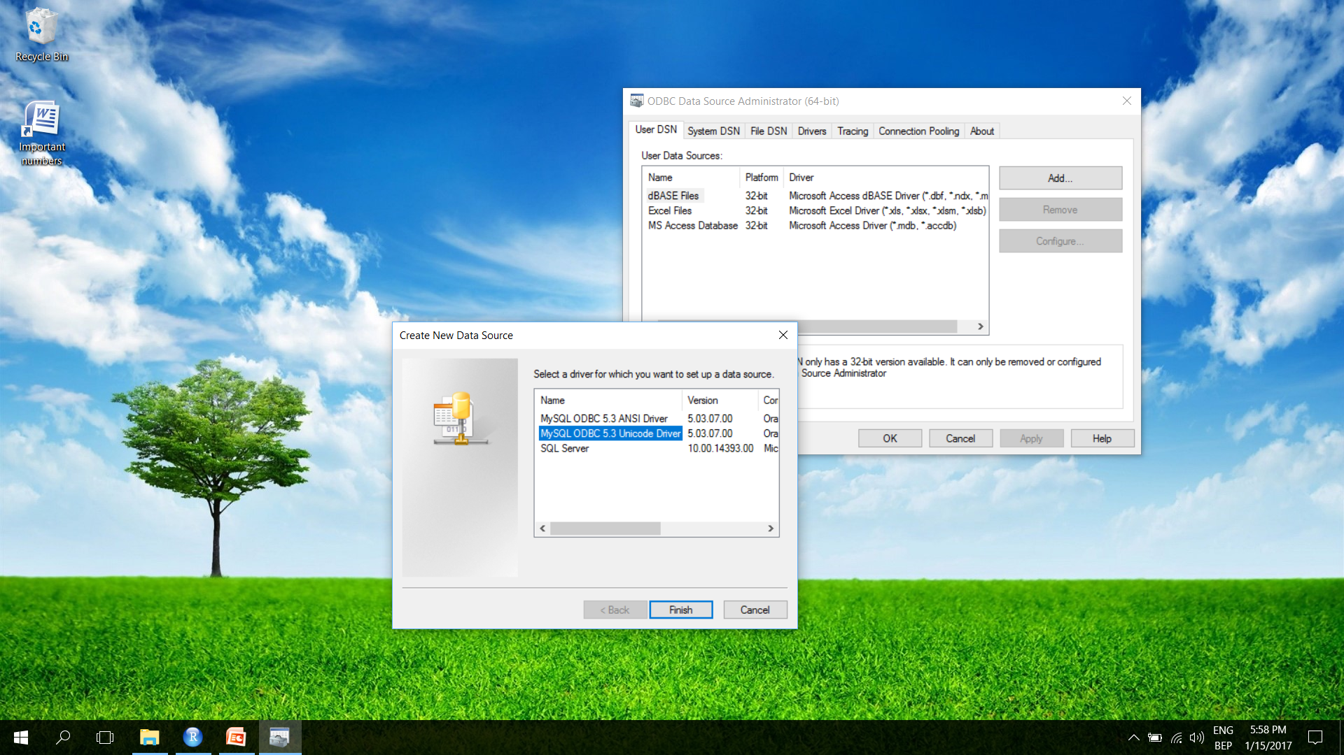
Create an ODBC connection

Slide 32
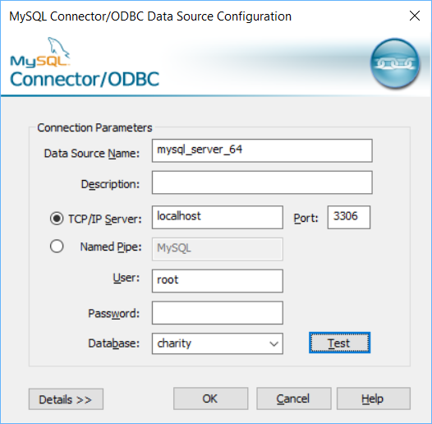
Configure it

Slide 33
And then, magic happens…
# Install the RODBC package (required just once!!!)
install.packages("RODBC")
# Load the package
library(RODBC)
# Connect to you new data source
# Mine is “mysql_odbc_64”, with “root”/”” for credentials
db = odbcConnect("mysql_server_64", uid="root", pwd="")
# Load the first 1000 rows of a table into a data frame
query = "SELECT * FROM ma_charity_small.acts LIMIT 1000"
df = sqlQuery(db, query)
# If embedded in a function, use print(head(df)) instead
head(df)
# Close the connection
odbcClose(db)

Slide 34
Tips ans tricks

Slide 35
Pre-allocating memory
# Size of test
N = 30000
# Without pre-allocating memory
start_at = proc.time()
x = vector()
for (i in 1:N) {
x[i] = i
}
print(proc.time() - start_at)
# Pre-allocating memory makes a world of difference
start_at = proc.time()
x = vector(length = N)
for (i in 1:N) {
x[i] = i
}
print(proc.time() - start_at)

Slide 36
What happens in Vegas/a function…
# Function to change and assign values
changevalues = function() {
a = 10
b <- 10
c <<- 10
d <<- 10
e = 10
}
# Initialize
a = 1
b = 1
c = 1
# Execute function
changevalues()
# Show the changes (the last call will generate an error)
print(a)
print(b)
print(c)
print(d)
print(e)

Slide 37
That’s all folks !

